Slide 1
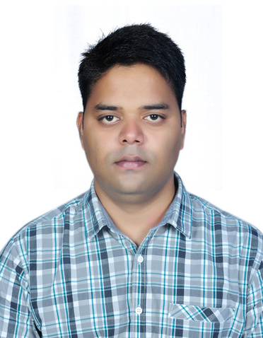










Amit Kumar
Bridging cutting-edge AI industry experience with academic mentoring and insight.
Past Roles & Organizations
Expertise
Dazn - Senior AI Architect (Head)
Leading AI strategy, implementation, and enterprise adoption
Entain - Machine Learning Lead
TensorFlow Certified Deep Learning Specialist – Google
Ericsson R&D (Global AI Accelerator) – Senior Data Scientist
Adjunct Faculty – BITS Pilani
Oracle India Pvt. Ltd. – Data Scientist
Technical Editor - Manning, Apress & Packt

